Slide 1

implementation of a virtual private cloud within CloudStack
Dustin Mcclure
Jonathan Korstad
Matthew Moklebust
Nekoashi Wolf

Slide 2


Introduction
The Apache Software Foundation lists these elements when defining CloudStack Virtual Private Cloud (VPC):
It is a private, isolated part of CloudStack
It can have its own virtual Network topology that resembles a traditional physical Network
Instances launched in the virtual Network can have private addresses in the range of your choice (Ex: 10.0.0.0/16)
Notes:
Quote:
“CloudStack virtual private cloud is a private, isolated part of CloudStack. A VPC can have its own virtual network topology that resembles a traditional physical network. You can launch instances in the virtual network that can have private addresses in the range of your choice, for example: 10.0.0.0/16. You can define network tiers within your VPC network range, which in turn enables you to group similar kinds of instances based on IP address range.” (Apache CloudStack n.d.)

Slide 3


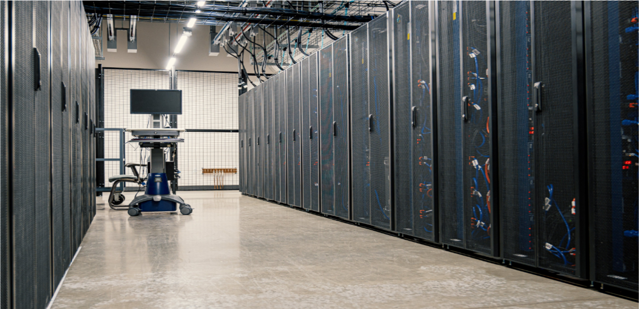


goal
Implementation of a virtual private cloud
Tools used
Apache CloudStack
Google Cloud Platform
CentOS Virtual Machines
Notes:
We will be using CloudStack on Google Cloud with Ubuntu and CentOS virtual machines.

Slide 4
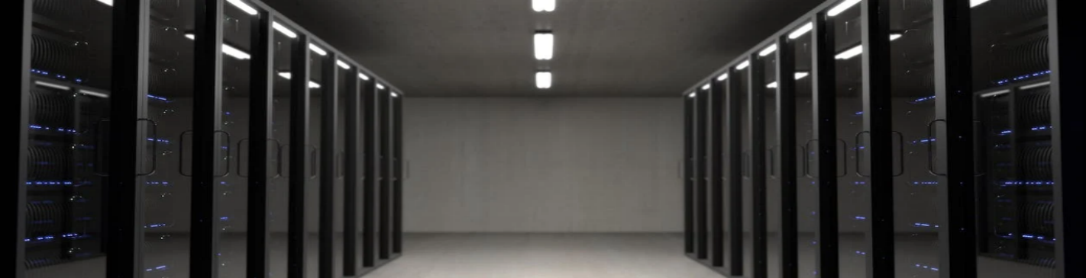
Advantages of a vpc
Scalability and Flexibility
Isolation and Security
Customization and Control
Compliance and Governance
High Availability
Notes:
SCALABILITY AND FLEXIBILITY
CAN GROW OR SHRINK ACCORDING TO ORGANIZATIONS NEEDS, CAN QUICKLY IMPLEMENT TEMPORARY CHANGES AS NEEDED
ISOLATION AND SECURITY
PROVIDES ISOLATION FROM THE PUBLIC CLOUD AND OPTIONS TO IMPLEMENT HIGH SECURITY FEATURES
CUSTOMIZATION AND CONTROL
CUSTOMIZATIONS CAN INCREASE AS THE ADMINISTRATOR LEARNS THE POSSIBILITIES WITHIN CLOUDSTACK, AND ADMIN HAS THE POWER TO CONTROL THE TOPOLOGY, TRAFFIC AND RESOURCES
COMPLIANCE AND GOVERNANCE
CLOUDSTACK CAN MAKE IT RELATIVELY EASY TO IMPLEMENT COMMON COMPLIANCE PRACTICES—OR AT LEAST KNOW THAT IS OR ISN’T IMPLEMENTED AND ENSURE THE VPC IS ADMINISTERED ACCORDING TO ORGANIZATION GOVERNANCE
HIGH AVAILABILITY
THIS SOLUTION IS NOT SO READILY AFFECTED BY USE OF PUBLIC CLOUD RESOURCES; ADMINS CAN THEREFORE CCONFIGURE AND IMPLEMENT A SYSTEM THAT HAS RELIABLE AVAILABILITY AND PRIORITIZE WHERE AVAILABILITY SHOULD BE HIGHEST

Slide 5




Personnel Costs Complexity Compliance/Legal concerns
DISADVANTAGES OF A VPC
Notes:
PERSONNEL COSTS
EXPERIENCED NETWORK ADMINISTRATOR NECESSARY TO PREVENT ERRORS/PROBLEMS
COMPLEXITY
THE PROCESS OF PROPERLY IMPLEMENTING AND CONFIGURING CAN BE QUITE COMPLICATED
COMPLIANCE/LEGAL CONCERNS
OPERATING AN ORGANIZATION WITHIN THIS TYPE OF VPC MEANS THE LEGAL COMPLIANCES AND RESPONSIBILITIES ARE HELD BY THE ORGANIZATION, RATHER THAN A CLOUD SERVICE PROVIDER

Slide 6



Components of a Virtual private Cloud
VPC
Network Tiers
Virtual Router
Public Gateway
Private Gateway
VPN Gateway
Site-to-Site VPN Connection
Customer Gateway
NAT Instance
Network ACL
Notes:
Apache CloudStack states that a VPC is comprised of the following components:
VPC: A VPC acts as a container for multiple isolated Networks that can communicate with each other via its virtual router.
Network Tiers: Each Network Tier acts as an isolated Network with its own VLANs and CIDR list, where you can place groups of resources, such as Instances. The Network Tiers are segmented by means of VLANs. The NIC of each Network Tier acts as its gateway.
Virtual Router: A virtual router is automatically created and started when you create a VPC. The virtual router connect the Network Tiers and direct traffic among the public gateway, the VPN gateways, and the NAT Instances. For each Network Tier, a corresponding NIC and IP exist in the virtual router. The virtual router provides DNS and DHCP services through its IP.
Public Gateway: The traffic to and from the Internet routed to the VPC through the public gateway. In a VPC, the public gateway is not exposed to the end user; therefore, static routes are not support for the public gateway.
Private Gateway: All the traffic to and from a private Network routed to the VPC through the private gateway.
VPN Gateway: The VPC side of a VPN connection.
Site-to-Site VPN Connection: A hardware-based VPN connection between your VPC and your datacenter, home Network, or co-location facility.
Customer Gateway: The customer side of a VPN Connection.
NAT Instance: An Instance that provides Port Address Translation for Instances to access the Internet via the public gateway.
Network ACL: Network ACL is a group of Network ACL items. Network ACL items are nothing but numbered rules that are evaluated in order, starting with the lowest numbered rule. These rules determine whether traffic is allowed in or out of any Network Tier associated with the Network ACL.
(Apache CloudStack n.d.)

Slide 7
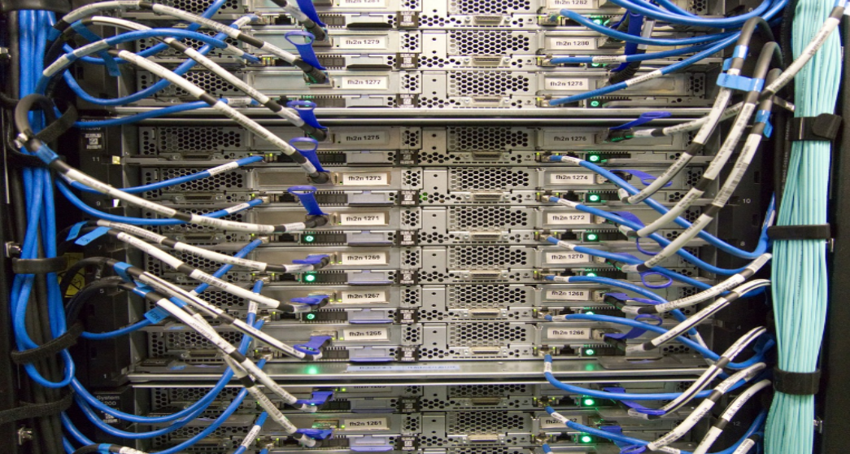
Network architecture
configurations
connectivity
Public gateway only
Public and private gateways
Public and private gateways and VPNs
Private gateway only and VPNs
Through the internet using a public gateway.
Using a site-to-site VPN through a public gateway.
Both options can be used simultaneously.

Slide 8
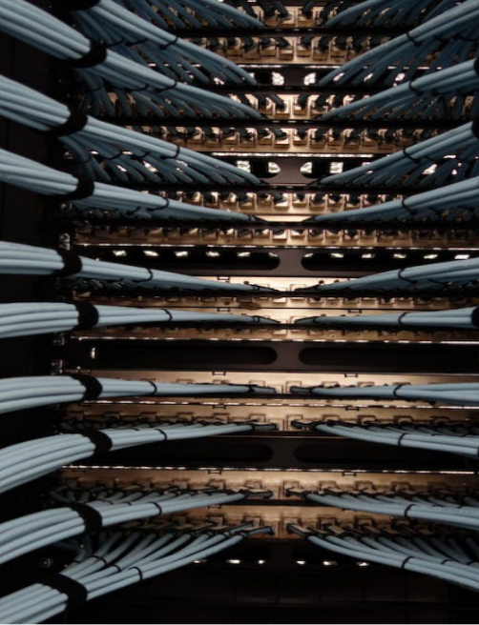
VPC Configuration
Advanced Zone Physical Network Configuration
Adding a Virtual Private Cloud
Adding Network Tiers
Deploying Instances to the Tier
Acquiring a New IP Address for a VPC
Releasing an IP Address Allotted to a VPC
Enabling or Disabling Static NAT on a VPC
Removing Tiers
Editing, Restarting, and Removing a VPC

Slide 9

Processes that worked
Management Server Configuration
Storage Configuration
Zone, Pod, Cluster, Host, Primary and Secondary Storage Configuration

Slide 10

Processes that did not work
IP Addressing
Virtual Routing
Trouble with deleting configurations

Slide 11
Summary
Many facets of a VPC can be beneficial to organizations contemplating moving their computing infrastructure to the cloud
CloudStack can be configured to have many VPCs to serve customers with highest security needs for their cloud computing resources
The foundation for this can be accomplished relatively quickly with basic knowledge of the CloudStack application.
Notes:
There are many facets of a VPC that can be beneficial to organizations that are contemplating moving their computing infrastructure to the cloud. CloudStack can be configured to have many virtual private networks to serve customers who need the highest level of security for their cloud computing resources. This can be accomplished in a relatively short amount of time with basic knowledge of the CloudStack application.

Slide 12

Thank you
Dustin M^{c}Clure
Jonathan Korstad
Mathew Moklebust
Nekoashi Wolf

